Slide 1



Final Project
Presented by:
Ben Vaizman , Dor Dahan ,
Ron Shlemovich , Jonathan Stelmach.

Slide 2
Table of contents
Network Topology
Addressing Table
Single area OSPF
LACP
HSRP
GRE OVER IP SEC Tunneling
ACL
DHCP
Security
Automation
Show Commands

Slide 3
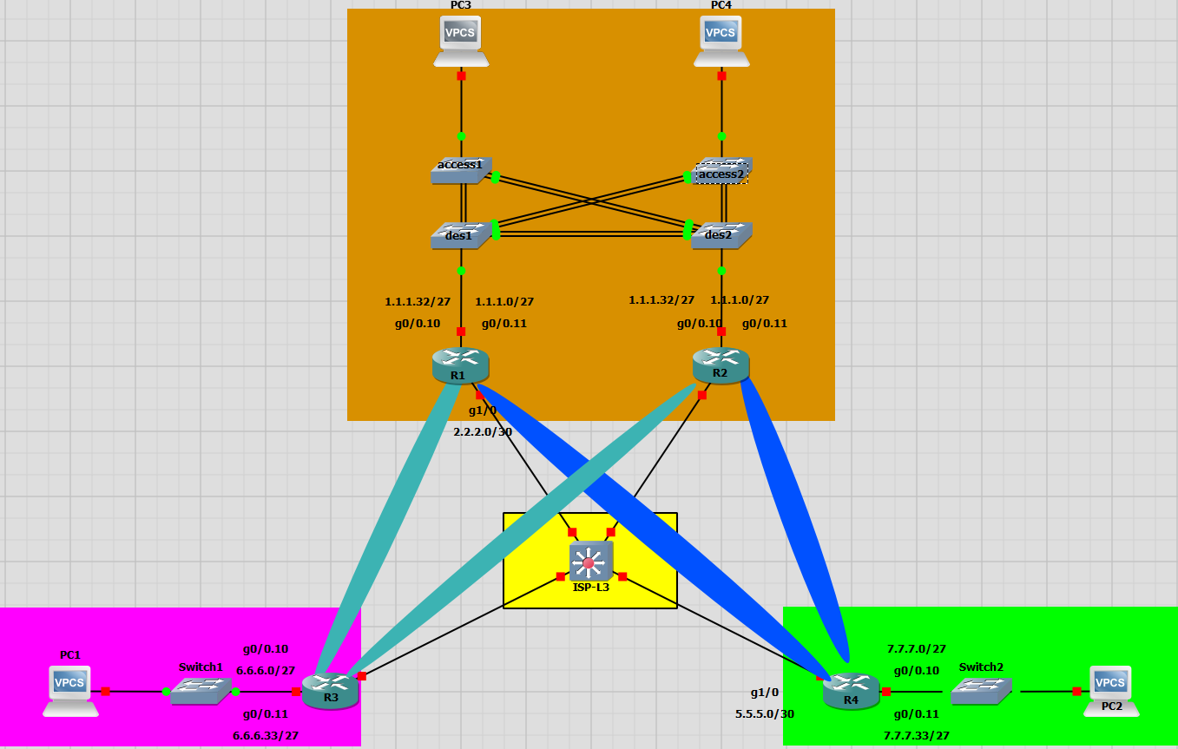

Topology

Slide 4
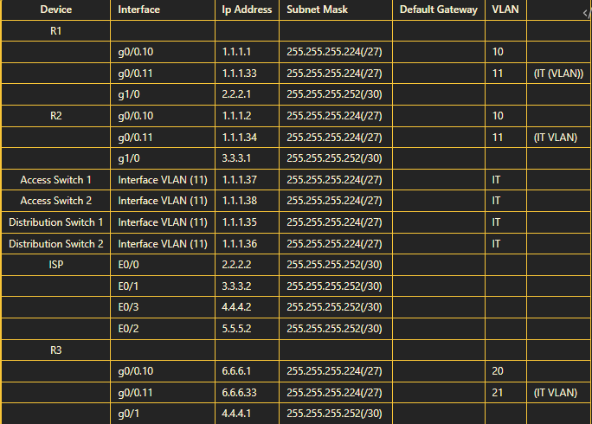


Addressing Table-1

Slide 5
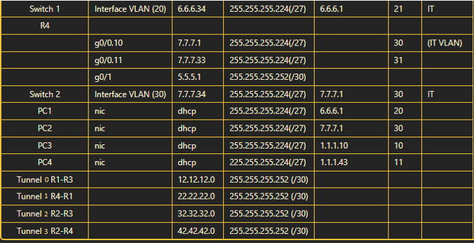
Addressing Table-2

Slide 6
Single area OSPF
Single Area OSPF: All routers in the OSPF network belong to a single OSPF area, typically Area 0 (backbone area). Suitable for smaller networks, it simplifies OSPF configuration. As the network grows, multi-area OSPF might be needed for better scalability.
We used Single area OSPF , because its routing protocol for our small network.

Slide 7
LACP
LACP (Link Aggregation Control Protocol) combines multiple physical network links into a single logical channel for improved bandwidth, fault tolerance, and load balancing. It dynamically manages the aggregation between compatible devices.
We used LACP to improve bandwidth, fault tolerance, and load balancing

Slide 8
HSRP
HSRP (Hot Standby Router Protocol) enables multiple routers to operate together, presenting a single virtual gateway IP. It ensures network availability by seamlessly transitioning to a standby router in case of a failure.
We used HSRP to enable the 2 routers of our HQ to operate together to create redundancy.

Slide 9
GRE Over IP SEC Tunneling
GRE over IPsec combines Generic Routing Encapsulation with Internet Protocol Security for secure communication in VPNs. It encapsulates data for transmission (GRE) and adds security (IPsec), ensuring encrypted and authenticated connections between network devices.
We used GRE Over IP SEC Tunneling to create tunnels between every router on our Sb’s

Slide 10
ACL
ACL: Access Control List. A set of rules that govern what actions are permitted or denied for users, systems, or network traffic. Used in networking and security to control access to resources and enhance overall system security.
We used ACL to restrict IT remote control management.

Slide 11
DHCP
DHCP: Dynamic Host Configuration Protocol. Automatically assigns IP addresses and network configuration to devices on a network. Simplifies network administration by dynamically managing IP allocations, making it easier to connect devices without manual configuration.
We used DHCP to give IP addresses to each pc on the topology

Slide 12
Security
We used sshv2 and port security as are security tools in the project
Port security on switches controls access by associating specific MAC addresses with switch ports. It prevents unauthorized devices from connecting, enforcing restrictions and triggering actions on violation. This enhances network security by mitigating risks and limiting access based on MAC address filtering.
SSHv2, or Secure Shell Version 2, is a secure protocol for remote communication over untrusted networks. It encrypts data during transmission, provides strong user authentication, and supports various cryptographic algorithms. SSHv2 allows secure remote access to servers, supports multiplexing for multiple sessions, and enables tunneling of other network protocols. It is an improved version over SSHv1, addressing security vulnerabilities and enhancing overall performance.

Slide 13
Automation-1
We used ansible as our Automation tool for the project
Ansible is an open-source automation tool that operates agentlessly over SSH. It uses YAML for configuration files (playbooks) and simplifies tasks like configuration management and application deployment. Ansible's idempotent nature ensures that tasks are safe to repeat, and its modular design supports integration with various technologies. It's known for its simplicity, extensibility, and active community.

Slide 14
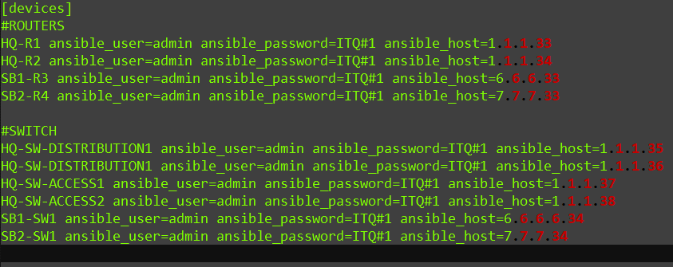
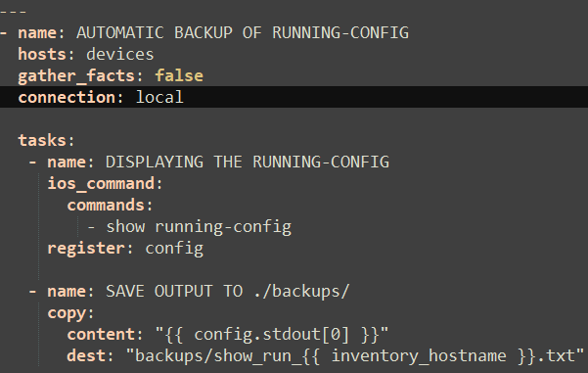
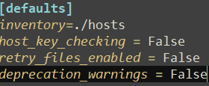
Automation-2
yaml
Host
Ansible.cfg -

Slide 15



Show Commands-1
Ospf
show ip ospf interface brief
Interface PID Area IP Address/Mask Cost State Nbrs F/C
Tu2 1 0 32.32.32.2/30 25 P2P 0/0
Tu0 1 0 12.12.12.2/30 25 P2P 1/1
Gi0/0.11 1 0 6.6.6.33/27 1 DR 0/0
Gi0/0.10 1 0 6.6.6.1/27 1 DR 0/0
show ip ospf neighbor
Neighbor ID Pri State Dead Time Address Interface
4.4.4.4 0 FULL/ - 00:00:24 22.22.22.2 Tunnel1
3.3.3.3 0 FULL/ - 00:00:23 12.12.12.2 Tunnel0

Slide 16
Show Commands-2
show ip route ospf
Gateway of last resort is 2.2.2.2 to network 0.0.0.0
6.0.0.0/27 is subnetted, 2 subnets
O 6.6.6.0 [110/26] via 12.12.12.2, 00:04:32, Tunnel0
O 6.6.6.32 [110/26] via 12.12.12.2, 00:04:32, Tunnel0
7.0.0.0/27 is subnetted, 2 subnets
O 7.7.7.0 [110/26] via 22.22.22.2, 00:04:22, Tunnel1
O 7.7.7.32 [110/26] via 22.22.22.2, 00:04:22, Tunnel1
32.0.0.0/30 is subnetted, 1 subnets
O 32.32.32.0 [110/50] via 12.12.12.2, 00:04:32, Tunnel0
show ip ospf database
Link ID ADV Router Age Seq# Checksum Link count
1.1.1.1 1.1.1.1 289 0x80000004 0x009612 6
3.3.3.3 3.3.3.3 295 0x80000002 0x00B926 5
4.4.4.4 4.4.4.4 287 0x80000003 0x0071A9 4

Slide 17
Show Commands-3
DHCP
show ip dhcp pool
Pool HQ1-MAIN :
Utilization mark (high/low) : 100 / 0
Subnet size (first/next) : 0 / 0
Total addresses : 30
Leased addresses : 0
Pending event : none
1 subnet is currently in the pool :
Current index IP address range Leased addresses
1.1.1.1 1.1.1.1 - 1.1.1.30 0
Pool HQ1-IT :
Utilization mark (high/low) : 100 / 0
Subnet size (first/next) : 0 / 0
Total addresses : 30
Leased addresses : 0
Pending event : none
1 subnet is currently in the pool :
Current index IP address range Leased addresses
1.1.1.33 1.1.1.33 - 1.1.1.62 0

Slide 18
Show Commands-4
show ip dhcp binding
IP address Client-ID/ Lease expiration Type
Hardware address/
User name
1.1.1.11 0100.5079.6668.00 Nov 24 2023 11:57 AM Automatic
1.1.1.44 0100.5079.6668.01 Nov 23 2023 12:02 PM Automatic
LACP-
show etherchannel summary
Group Port-channel Protocol Ports
------+-------------+-----------+-----------------------------------------------
1 Po1(SU) LACP Et1/0(P) Et1/1(P)
2 Po2(SU) LACP Et0/1(P) Et0/2(P)
3 Po3(SU) LACP Et1/2(P) Et1/3(P)

Slide 19
Show Commands-5
show lacp internal
Channel group 1
LACP port Admin Oper Port Port
Port Flags State Priority Key Key Number State
Et1/0 SA bndl 32768 0x1 0x1 0x101 0x3D
Et1/1 SA bndl 32768 0x1 0x1 0x102 0x3D
Channel group 2
LACP port Admin Oper Port Port
Port Flags State Priority Key Key Number State
Et0/1 SA bndl 32768 0x2 0x2 0x2 0x3D
Et0/2 SA bndl 32768 0x2 0x2 0x3 0x3D
Channel group 3
LACP port Admin Oper Port Port
Port Flags State Priority Key Key Number State
Et1/2 SA bndl 32768 0x3 0x3 0x103 0x3D
Et1/3 SA bndl 32768 0x3 0x3 0x104 0x3D

Slide 20
Show Commands-6
HSRP
show standby brief
Interface Grp Pri P State Active Standby Virtual IP
Gi0/0.10 10 110 P Active local 1.1.1.2 1.1.1.10
Gi0/0.11 11 100 Standby 1.1.1.34 local 1.1.1.43
show crypto isakmp policy
Protection suite of priority 10
encryption algorithm: AES - Advanced Encryption Standard (256 bit keys).
hash algorithm: Secure Hash Standard 2 (256 bit)
authentication method: Pre-Shared Key
Diffie-Hellman group: #14 (2048 bit)
lifetime: 3600 seconds, no volume limit

Slide 21
Show Commands-7
show crypto isakmp sa
IPv4 Crypto ISAKMP SA
dst src state conn-id status
5.5.5.1 2.2.2.1 QM_IDLE 1004 ACTIVE
2.2.2.1 4.4.4.1 QM_IDLE 1002 ACTIVE
4.4.4.1 2.2.2.1 QM_IDLE 1001 ACTIVE
2.2.2.1 5.5.5.1 QM_IDLE 1003 ACTIVE
show crypto map
Crypto Map IPv4 "Tunnel0-head-0" 65537 ipsec-isakmp
Map is a PROFILE INSTANCE.
Peer = 4.4.4.1
Extended IP access list
access-list permit gre host 2.2.2.1 host 4.4.4.1
Current peer: 4.4.4.1
Security association lifetime: 4608000 kilobytes/3600 seconds
Responder-Only (Y/N): N
PFS (Y/N): N
Mixed-mode : Disabled
Transform sets={
GRE-TUN1: { esp-256-aes esp-sha256-hmac }

Slide 22
Show Commands-8
ACL
show ip access-lists
Standard IP access list VTY-LINES
10 permit 1.1.1.32, wildcard bits 0.0.0.31
20 permit 6.6.6.32, wildcard bits 0.0.0.31
30 permit 7.7.7.32, wildcard bits 0.0.0.31
40 deny any
SSH
show ip ssh
SSH Enabled - version 2.0
Authentication methods:publickey,keyboard-interactive,password
Authentication timeout: 120 secs; Authentication retries: 3
Minimum expected Diffie Hellman key size : 1024 bits
IOS Keys in SECSH format(ssh-rsa, base64 encoded):
ssh-rsa AAAAB3NzaC1yc2EAAAADAQABAAAAgQDnDnpGQYNrfUTTC163qlw2/XMXeX85U8JPHzfDIMqN
Jcti5alDuuHt4yxlmRyw2x6sV+WINS+7jGpAk+NpHOvE3C1fzGhspJfXO8OrlHIGnMXizSr60SqqIcnR
lBgqUFUhxDPMDcAZLaKKyKgocTGE5RlJJf4fRrxCq5o2lNYTcw==

Slide 23
Show Commands-9
port-security
show port-security interface ethernet 0/0
Port Security : Enabled
Port Status : Secure-up
Violation Mode : Restrict
Aging Time : 0 mins
Aging Type : Absolute
SecureStatic Address Aging : Disabled
Maximum MAC Addresses : 1
Total MAC Addresses : 1
Configured MAC Addresses : 0
Sticky MAC Addresses : 1
Last Source Address:Vlan : 0050.7966.6801:11
Security Violation Count : 0
show port-security address
Vlan Mac Address Type Ports Remaining Age
(mins)
---- ----------- ---- ----- -------------
11 0050.7966.6801 SecureSticky Et0/0 -
-----------------------------------------------------------------------------
Total Addresses in System (excluding one mac per port) : 0
Max Addresses limit in System (excluding one mac per port) : 4096
show port-security address sticky

